Slide 1
From Output to Outcome
- Agile2018 Report -
Hiroyuki Ito

Slide 2
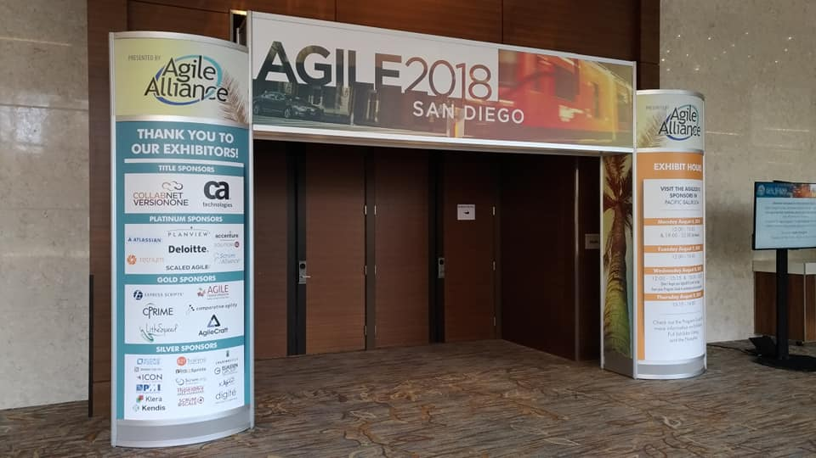
Open Your Gate

Slide 3
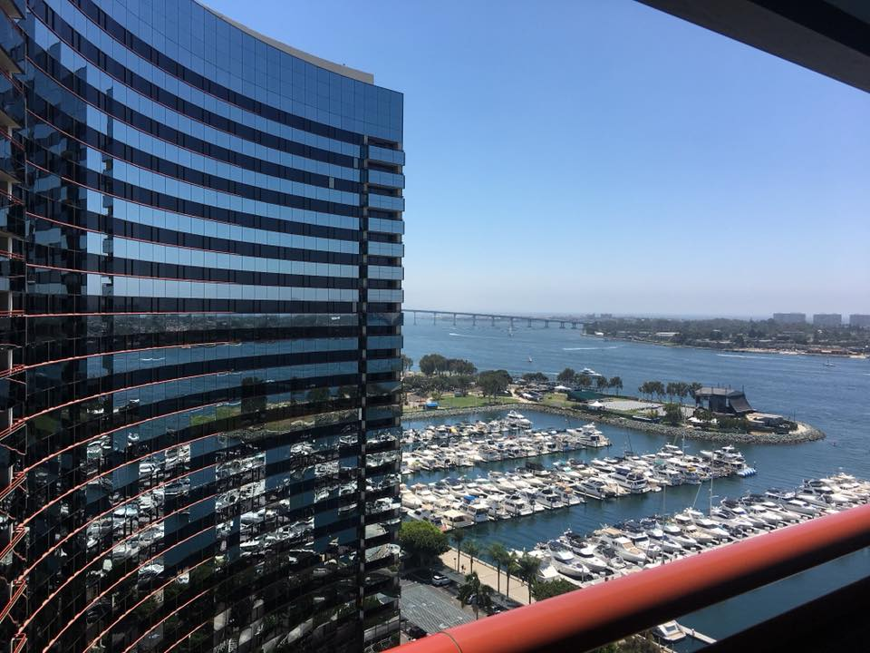
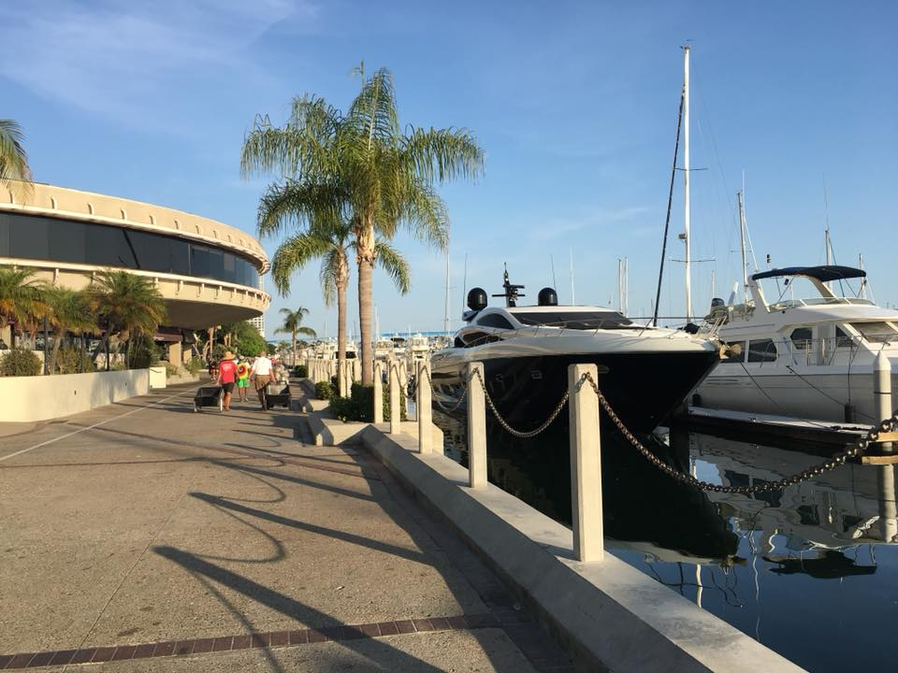

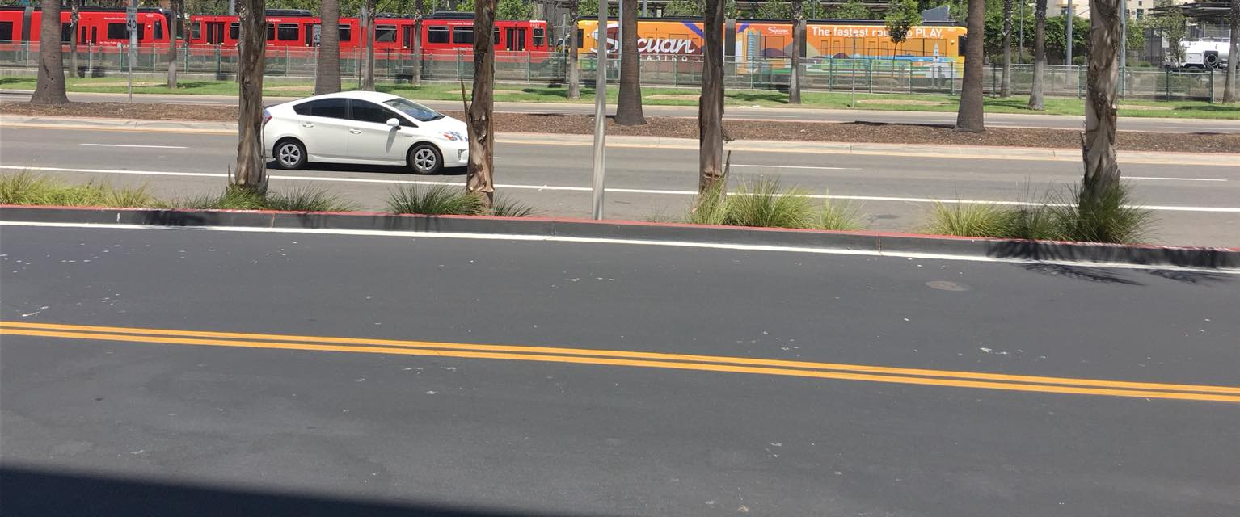
In San Diego, CA, USA

Slide 4
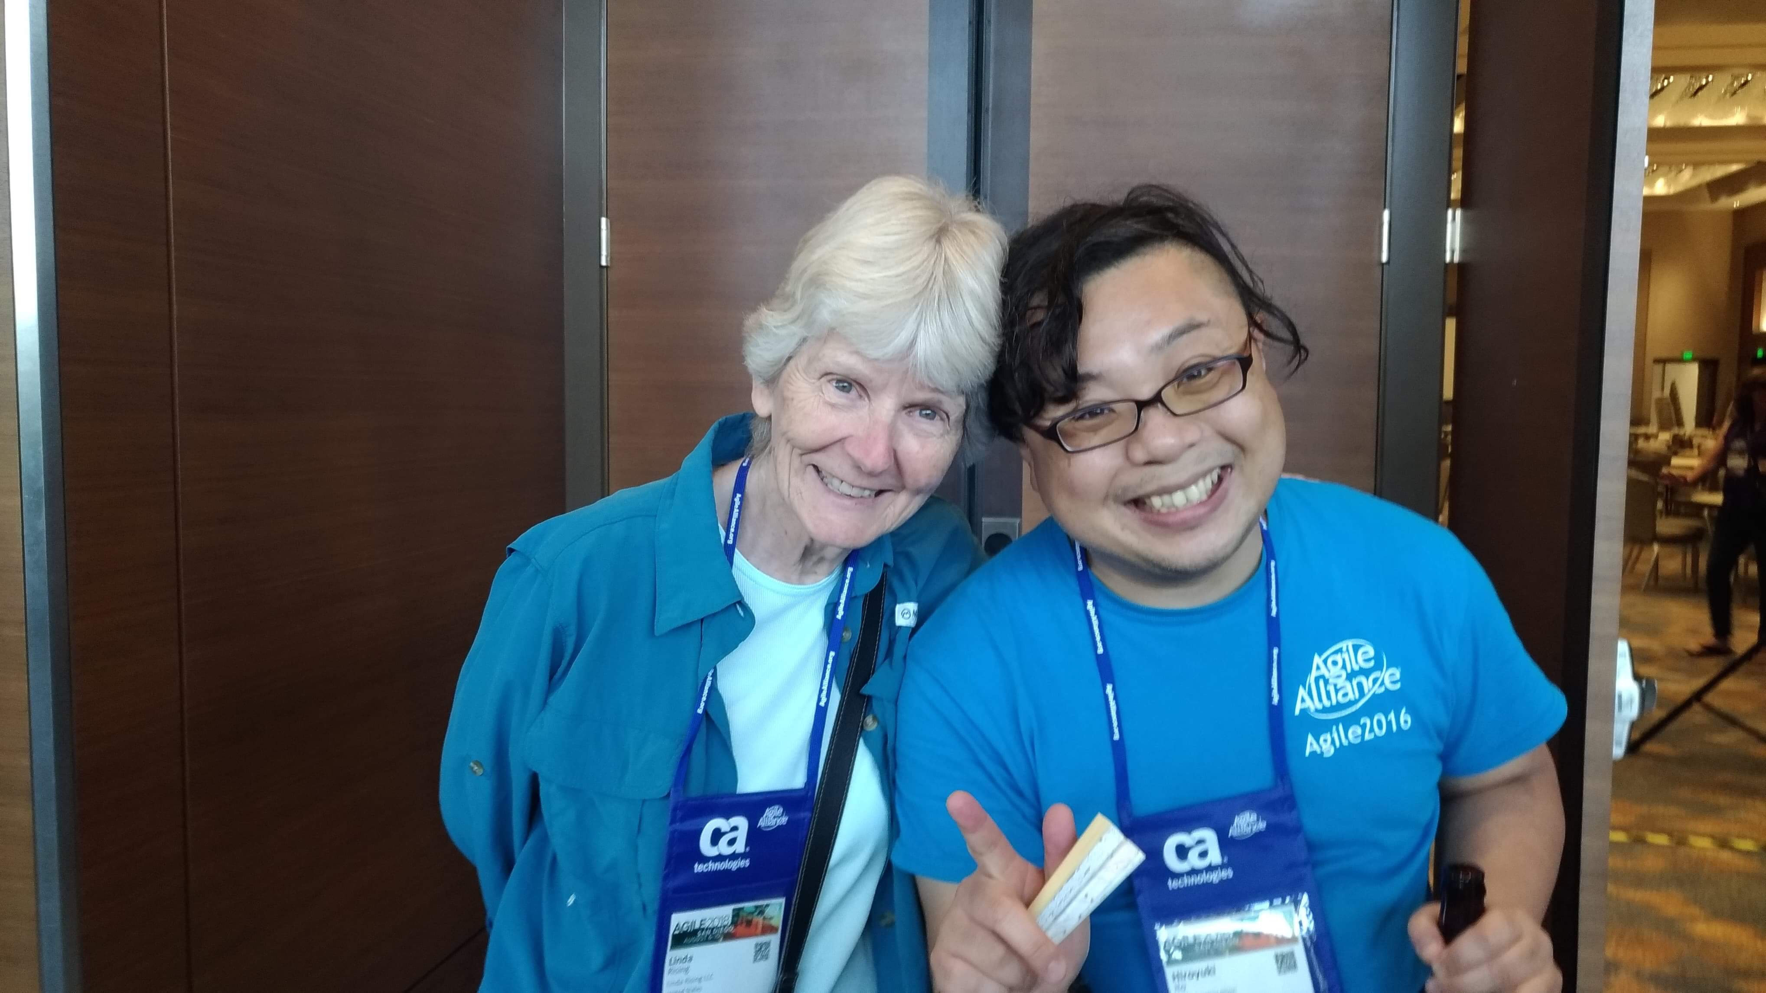
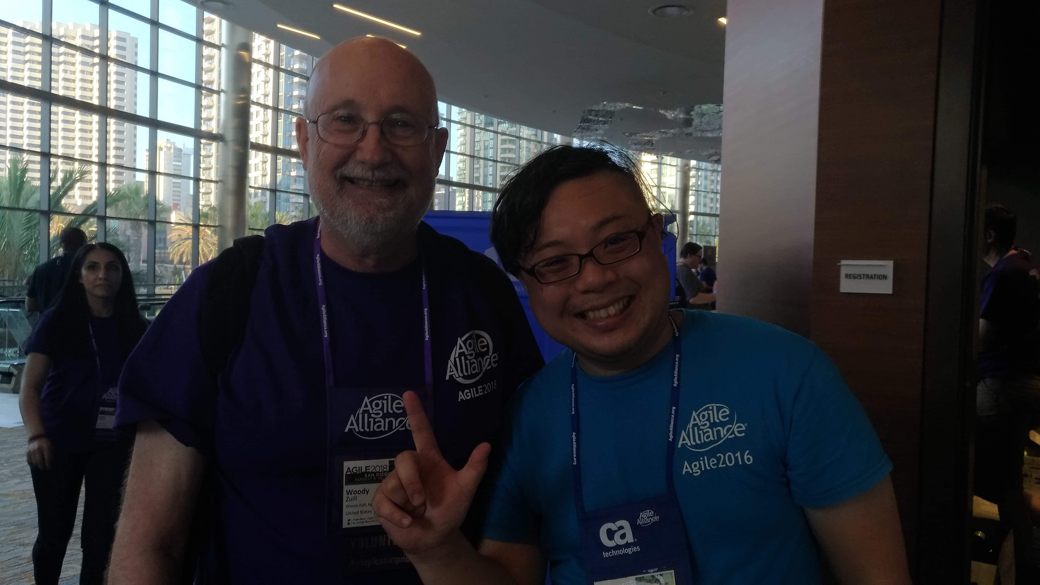
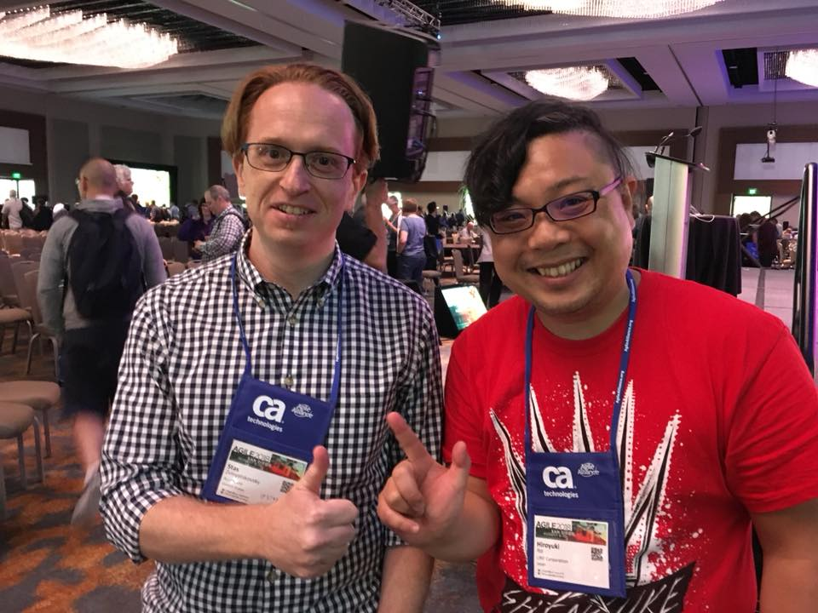
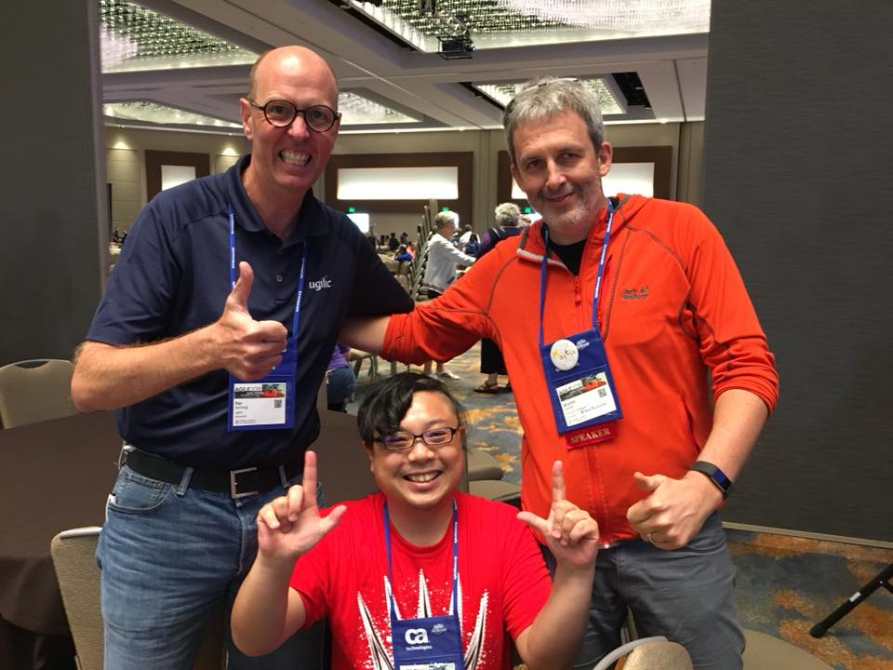
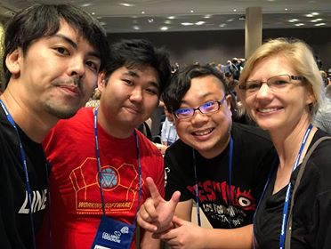
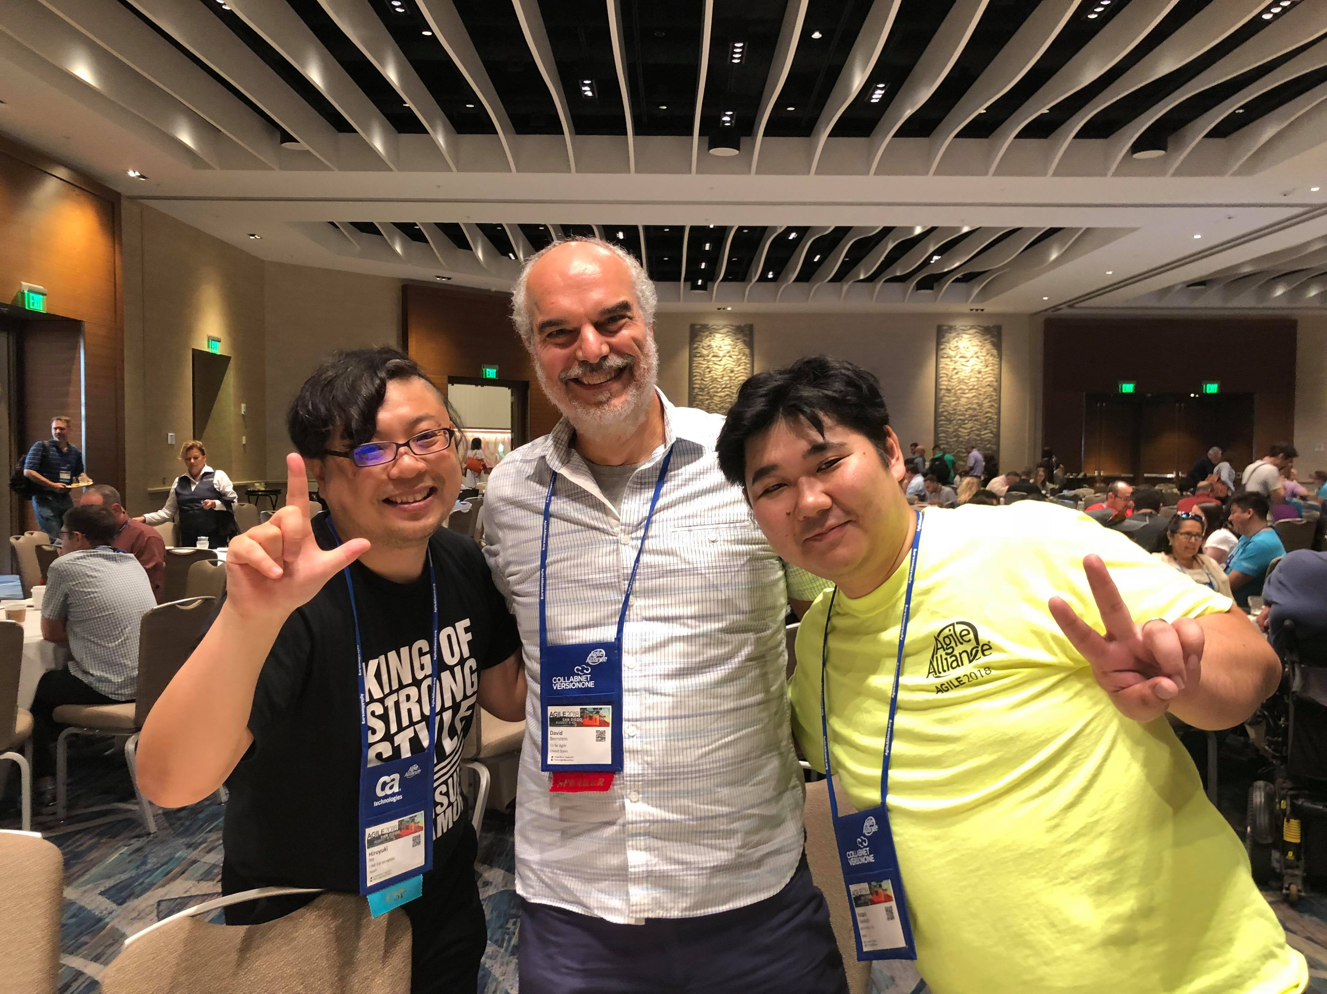
With Global Practitioners!

Slide 5
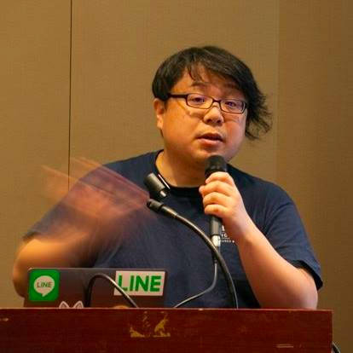


Hiroyuki Ito (The HIRO)
@hageyahhoo
The 1st SET at LINE Corp.
Keynote Speaker of DevOps Summit 2016 (TW)
Speaker of Agile2014

Slide 6
$ history
6 times attendee from Japan!
[Reports]
Agile2017 (JP)
Agile2016 (JP)
Agile2014 (EN)
Agile2013 (JP)
Agile2012 (JP)

Slide 7
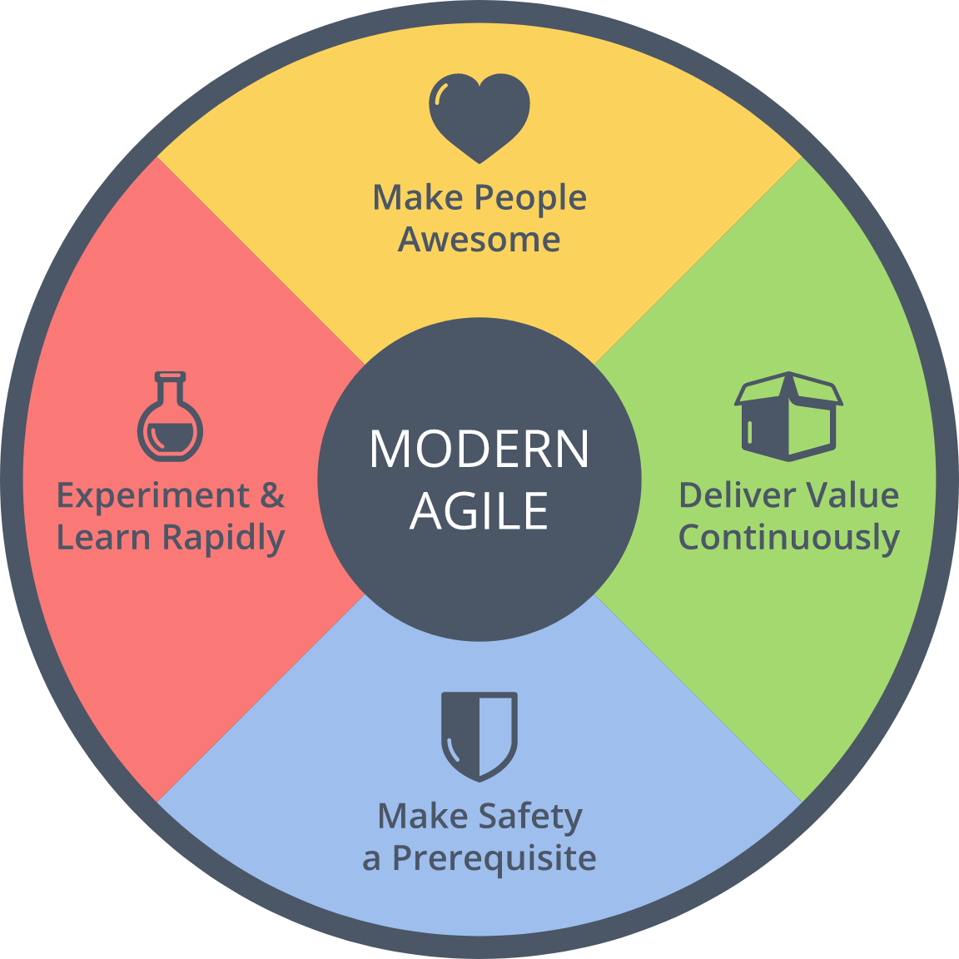
$ history
Achievements
2016 : Brought back
2014 : Speaker
Brought back Metrics
2013 : Speech at OpenJam

Slide 8

What is Agile2018?
https://www.agilealliance.org/agile2018/
Annual global conference of Agile in USA
The biggest one of Agile
Held by Agile Alliance

Slide 9
Basic Information
Duration | Aug. 6th – 10th (5 days)
# of Sessions | 279 (+5 YoY)
# of Categories | 21 (±0 YOY)
# of Parallel On-going Sessions | 20 (+1 YoY)
# of Attendees | 2,500
Type of Sessions | Talk/Workshop
Level of Sessions | Learning/Practicing/ Advancing

Slide 10
Categories (2018)
Category | # | Category | #
Agile Companies | 16 | Keynotes | 3
Agile Data Metrics and Forecasting | 6 | Leadership | 21
Agile Foundations | 7 | Learning | 19
Agile Midway | 7 | Project Program & Portfolio Management | 18
Coaching & Mentoring | 21 | Testing & Quality | 12
Collaboration Culture & Teams | 24 | User Experience | 12
Customers & Products | 15 | Experience Reports | 24
Dev Practices and Craft | 17 | The Future of Agile Software Development (IEEE Software) | 8
DevOps | 12 | Audacious Salon | 14
Enterprise Agile | 20 | Stalwarts | 10

Slide 11
Categories (2018)
Category | # | Category | #
Agile Companies | 16 | Keynotes | 3
Agile Data Metrics and Forecasting | 6 | Leadership | 21
Agile Foundations | 7 | Learning | 19
Agile Midway | 7 | Project Program & Portfolio Management | 18
Coaching & Mentoring | 21 | Testing & Quality | 12
Collaboration Culture & Teams | 24 | User Experience | 12
Customers & Products | 15 | Experience Reports | 24
Dev Practices and Craft | 17 | The Future of Agile Software Development (IEEE Software) | 8
DevOps | 12 | Audacious Salon | 14
Enterprise Agile | 20 | Stalwarts | 10
Promoted as one category!

Slide 12
[FYI] Categories (2017)
Category | # | Category | #
Agile Alliance Lounge | 16 | Leadership | 21
Agile Companies | 13 | Learning | 17
Agile Foundations | 7 | Project Program & Portfolio Management | 21
Coaching & Mentoring | 17 | Testing & Quality | 12
Collaboration Culture & Teams | 24 | User Experience | 10
Customers & Products | 15 | Experience Reports | 24
Development Practices & Craftsmanship | 24 | The Future of Agile Software Development (IEEE Software) | 8
DevOps | 16 | Audacious Salon | 14
Enterprise Agile | 25 | Open Jam | 6
Keynotes | 3 | Stalwarts | 11

Slide 13
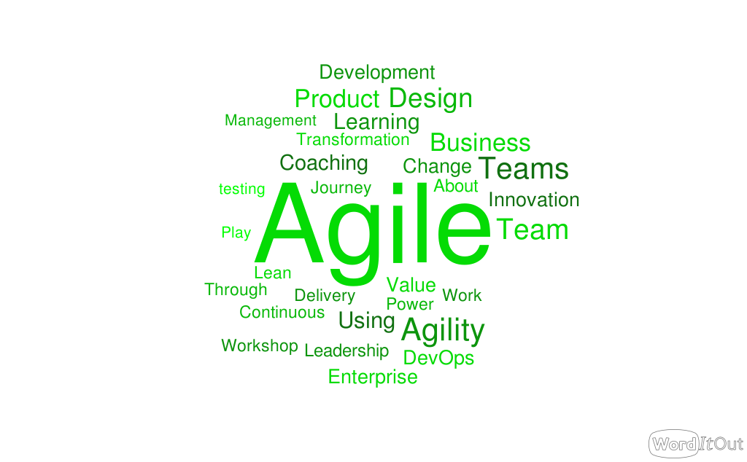
Trends of Agile2018

Slide 14
Trends of Agile2018
Agile @ scale
Business Agility
DevOps for ???

Slide 15
My Motivation
Need to LINE Corp.
Engineering
Scaling Agile
Testing

Slide 16
Agenda
1. Scaling Agile
2. Business Agility
3. Technologies for Trial & Errors
4. Other Topics
5. Conclusion

Slide 17
1. Scaling Agile
2. Business Agility
3. Technologies for Trial & Errors
4. Other Topics
5. Conclusion

Slide 18
Summary
Beyond IT
Utilize Agile to corporate level
Need to overcome silos

Slide 19
1. Scaling Agile
2. Business Agility
3. Technologies for Trial & Errors
4. Other Topics
5. Conclusion

Slide 20
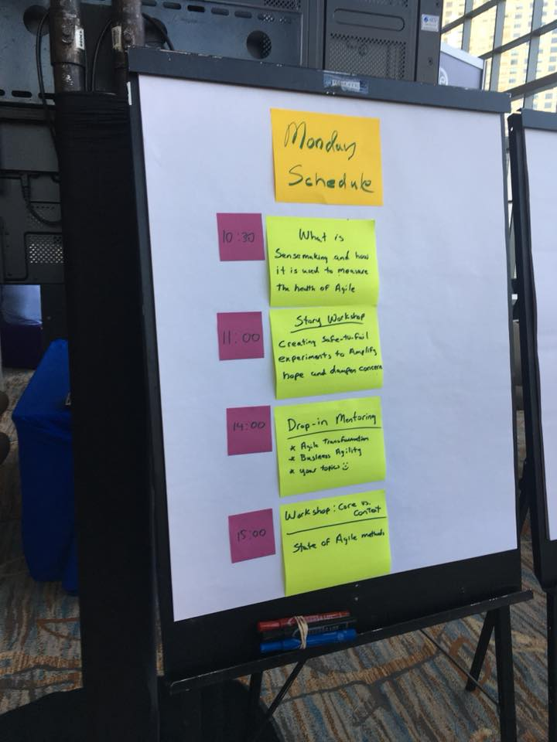
Summary
Beyond IT
Utilize Agile to corporate level
Need to overcome silos

Slide 21



解決方針
何らかの （動作する）成果物を 毎週作成・提示する

Slide 22

Making Impacts Constantly
“Managing impact for a team of TEs and SETs is the job of the TEM.”
from How Google Tests Software

Slide 23
1. Scaling Agile
2. Business Agility
3. Technologies for Trial & Errors
4. Other Topics
5. Conclusion

Slide 24
Learning to Experiment
aaa

Slide 25
Database DevOps
aaa

Slide 26
Radical Change for Testers
aaa

Slide 27
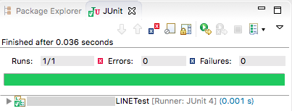
解決方針
自動テストを活用した
プロダクトの仕様・設計の把握
※画像はイメージです

Slide 28
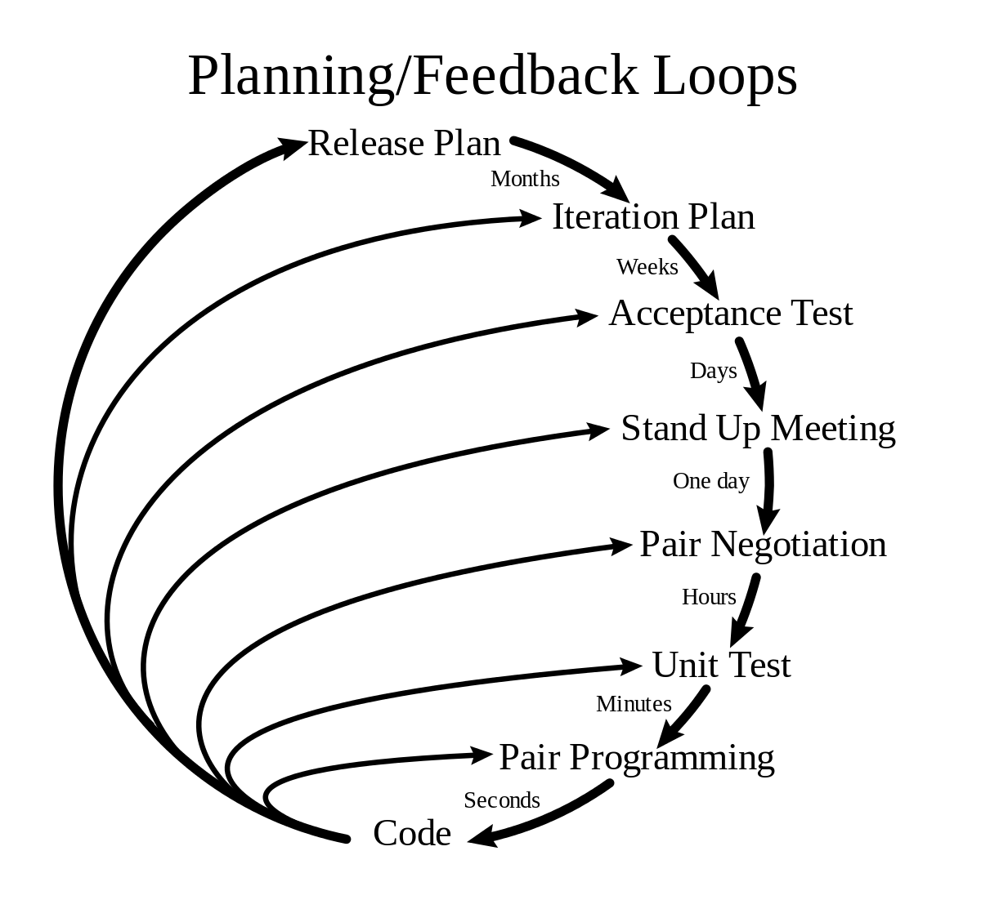
アジャイルの要素
XPを活用した
高速な学習の仕組みの構築と活用

Slide 29
自動テスト＝心理的安全性
（参考）Modern Agile
ここ！

Slide 30
1. Scaling Agile
2. Business Agility
3. Technologies for Trial & Errors
4. Other Topics
5. Conclusion

Slide 31
Testing
お手軽障害検知システムの構築
Spring BootでAPIを呼び出し、 その結果をJUnitで検証する （開発者に後日作り込んでもらうため）
Jenkinsで2分に1回のペースで実行
テストが失敗したら関係者にメール通知
開発チームのMTTR向上が当初の狙い

Slide 32
1. Scaling Agile
2. Business Agility
3. Technologies for Trial & Errors
4. Other Topics
5. Conclusion

Slide 33
これ
1. Moving toward business clearly
Development -> QA/PDM -> Company-wide
2. Utilize technologies for
outcome/value
tools for trial & error
3. Scaling?

Slide 34
Summary
Technology
+
Process
=
Improve Business

